Slide 1

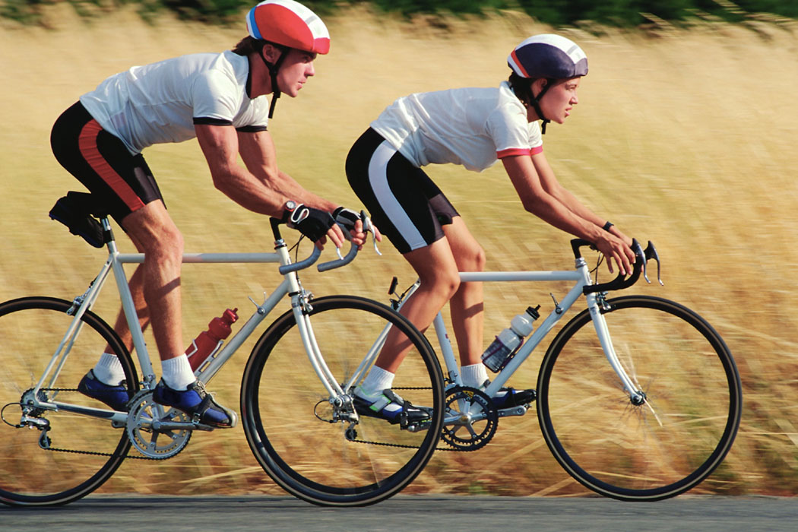
FACING UP
A GUIDE TO SELF DIRECTING WELLNESS

Slide 2

How Facing Up Works
Facing Up is a unique course in that we become the next co-facilitators
The recent graduates co-facilitate and train the next group and then they are able to co-facilitate and so on…
This way We take on a valued social role, and their investment in the learning process is increased
Individuals can train to be facilitators too

Slide 3

Course Overview
We draft a Wellness Vision for ourselves
We explore the automatic responses--the stress that everyone has
We discuss and explore our negative self-talk and begin to craft ways to shift those negative messages to positive and supportive self-talk
We complete a health screening and discuss how to be in a “relationship” with our PCP
We explore stress management
We discuss product labelling and develop a healthy meal plan
We discuss the power of good relationships
We explore finding a spiritual path of our choosing
The class develops an action plan to keep moving forward with their healthy lifestyle
We prepare to facilitate the next class

Slide 4
Unique Aspects of Facing Up
Facing up creates connections/friendships within the class and
to the community
As class members engage in each module, they are asked to call the YMCA, gyms, community centers, and other locations that may have fitness, dance, yoga, or other classes
We are asked to think about what activity they are willing and able to commit to, not what they think someone else thinks they should do—it needs to be what they wish to do
We can find people to come and talk to the class about Wellness, the facilitator and the class members can all take charge
The class takes field trips and packs healthy picnic lunches, they go to new places and do new things
Each day holds new possibilities and turns our personal wellness into a joyful journey

Slide 5
The training is facilitated in a manner that upholds Recovery Innovations’ principles and philosophy
That includes that the person is the expert on themselves and they are the leader in their care.

Slide 6
Disappointment
Difficulties

Slide 7
Diagnosis
Disappointment
Difficulties

Slide 8
Disease
Diagnosis
Disappointment
Difficulties

Slide 9
Disabled
Disease
Diagnosis
Disappointment
Difficulties

Slide 10
Disempowered
Disabled
Disease
Diagnosis
Disappointment
Difficulties

Slide 11
Disenfranchised
Disempowered
Disabled
Disease
Diagnosis
Disappointment
Difficulties

Slide 12
Demoralized
Disenfranchised
Disempowered
Disabled
Disease
Diagnosis
Disappointment
Difficulties

Slide 13
Dysfunctional
Demoralized
Disenfranchised
Disempowered
Disabled
Disease
Diagnosis
Disappointment
Difficulties

Slide 14
A person

Slide 15
Assets
A person

Slide 16
Abilities
Assets
A person

Slide 17
Achievements
Abilities
Assets
A person

Slide 18
Authentic
Achievements
Abilities
Assets
A person

Slide 19
Authority
Authentic
Achievements
Abilities
Assets
A person

Slide 20
Autonomous
Authority
Authentic
Achievements
Abilities
Assets
A person

Slide 21
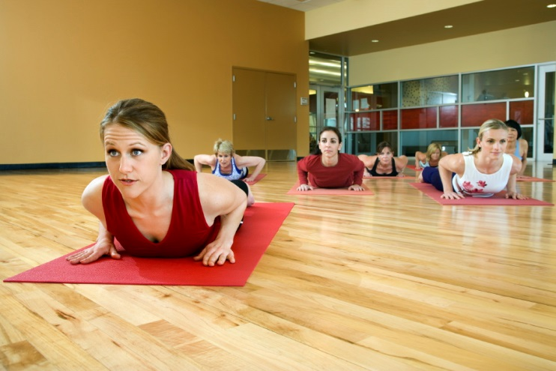
Modules One and Two
We take center stage on our wellness!
We become our personal wellness coach and begin to look at our own self-talk that can get in the way.
We look at keeping a positive focus in life and review Dr. David Hawkins, Map of Consciousness
There are lots of questions and areas for rich discussion in these two modules.

Slide 22
Map of Consciousness David Hawkins, M.D., Ph.D.
God-View | Life-View | Level | Log | Emotion | Process
Self | Is | Enlightenment | 700 + | Ineffable | Pure Consciousness
All-Being | Perfect | Peace | 600 | Bliss | Illumination
One | Complete | Joy | 540 | Serenity | Transfiguration
Loving | Benign | Love | 500 | Reverence | Revelation
Wise | Meaningful | Reason | 400 | Understanding | Abstraction
Merciful | Harmonious | Acceptance | 350 | Forgiveness | Transcendence
Inspiring | Hopeful | Willingness | 310 | Optimism | Intention
Enabling | Satisfactory | Neutrality | 250 | Trust | Release
Permitting | Feasible | Courage | 200 | Affirmation | Empowerment
Indifferent | Demanding | Pride | 175 | Scorn | Inflation
Vengeful | Antagonistic | Anger | 150 | Hate | Aggression
Denying | Disappointing | Desire | 125 | Craving | Enslavement
Punitive | Frightening | Fear | 100 | Anxiety | Withdrawal
Disdainful | Tragic | Grief | 75 | Regret | Despondency
Condemning | Hopeless | Apathy | 50 | Despair | Abdication
Vindictive | Evil | Guilt | 30 | Blame | Destruction
Despising | Miserable | Shame | 20 | Humiliation | Elimination
 |  | Death | 0
Power
+
_
Force
Notes:
This model is from David Hawkins, MD, PhD, Power vs. Force.
What Dr. Hawkins has done is calibrated the energy levels associated with various levels of consciousness. Notice the “life view” and “emotion” associated with each level. For apathy the life view is hopeless and the emotion is despair. You can give examples here. Apathy… a woman who’s son has been reported missing in action in the war sits day after day in her chair staring out the window. After many months, someone comes to the door with the news that her son has been found. In apathy she does not have the energy to respond and still sits staring out the window. If she moves up to “grief”, she begins to cry. Now there is more energy and the process of recovery begins. Someone in “fear” can run like hell to defend themselves. Hawkins says there were two people in history that had levels of “enlightenment”, Jesus and Buddha. Gandhi also had a level of 700 and this level of consciousness had enough power that he alone he was able to stop the British armies without firing a shot.
The pink levels are negative energy states. They attract more negatives. So we say “He’s having a run of back luck”, “nothing works out”, and so forth. The negative energy and negative level of consciousness just gets bigger. The level of courage is the neutral point between positive and negative levels. This is where recovery starts; the life view becomes “feasible” and the process is “empowerment”. As one moves to higher positive levels, reaching “willingness”, notice that the life-view is “hopeful” and there is “optimism”.
So how does change happen? In the negative levels, change happens by force. A good example of this is the “take down” or restraint event in a psychiatric hospital. If we are operating at a level of fear or anger, we have to use to force to change behavior. BUT, in the positive levels there is so much more energy that change happens simply by the power of the level of consciousness. Imagine LOVE! That has an energy level of 500, five times the energy of the level of fear! Imagine to power of four people on a team with a level of consciousness of love… that’s 2,000 compared to the 100 of fear. There is so much power that the person is just pulled up to the recovery (positive) levels.
So what does this mean for us? When we see someone in the low level of apathy, very despondent and despairing, they don’t have enough energy to move forward. So, Hawkins suggests that we “pour love into him” and that begins to move the person forward. Interesting that Dr. Hawkins calibrates the level of an Alcoholics Anonymous meeting at 500. He describes that meeting a “unconditional love”. AA says this is the principle of attraction not promotion. So, a person who has relapsed, gone out and done tragic things, comes back to the meeting and is welcomed unconditionally back to the group. The power of the group moves the person from the levels of shame and guilt right up to willingness, acceptance and recovery begins. In our lingo, we often refer to this as engagement.
Imagine the power of our environment if we consistently maintained a level of consciousness of LOVE.

Slide 23
The Importance of Primary Care
Identifying and choosing a primary care physician that works with us and “for” us is vital
We have the right to care that does not carry stigma
We have the right to care that takes the time to listen, and that believes we are the expert on ourselves
We learn to give the doctor a “check-up” to see if he/she works for our needs
We also learn tools to build the relationship from our side, we need to be part of the team
We prepare for our visit by creating a
plan and list of questions

Slide 24
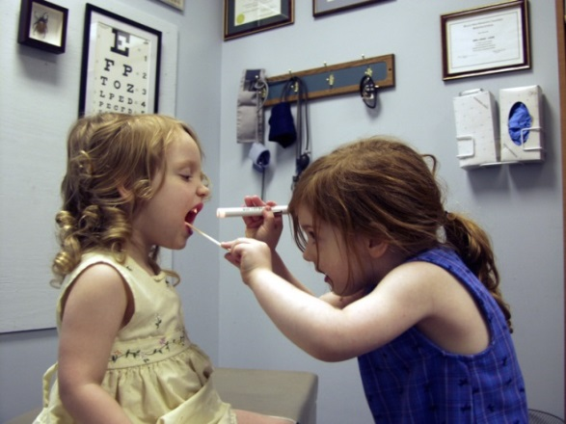
Physical Health Screening
We participate in a general physical health screening
Many sites where Facing Up is facilitated, have a nurse on staff to help with the screenings, or local universities can be called in to assist
The screening is easy and includes;
  Calculating each person’s BMI
  Taking each person’s blood pressure
  Taking a blood glucose measure
  Each person identifies their nicotine use and substance use levels
  Heart health and cholesterol levels need to be measured through blood tests ordered by your doctor
  We complete medication lists, side-effect check-list, and develop a plan prior to visiting with their doctor
  How many times have you left the doctor forgetting to ask the most important question you had?
  Health screening tools adapted with permission from: Health Passport: Your Journey to Wellness. Jonikas, J.A., Carter, T.M., Razzano, L., Swarbrick, P., Cook, J.A.. Chicago, IL: UIC Center on Psychiatric Disability and Co-occurring medical Conditions. 2011, University of Illinois.

Slide 25
Stress Management
We discuss personal insight and what tools they have used to manage stress
We discuss how stress can impact our physical health
We learn that we have choices about how we respond to worry, anger, frustration, and begin to understand “metamood”
We also begin to understand that we can increase our Emotional Intelligence throughout our lives, so we are not set in stone
We explore the stress response and relaxation
The class develops strategies for identifying stress and managing stress

Slide 26

Three Secrets to Good Health
Basic ONE: Eating Well
We learn about eating well and all that impacts being overweight or underweight
We learn about sugars and fats
We learn some tricks to manage our eating in healthy ways
Class members bring in food and class explores and reads labels
Basic TWO: Physical Exercise
We learn the seven benefits of exercise
Basic THREE: Getting Restful Sleep
We learn seven tips for getting
restful sleep

Slide 27
Plugging into Good Relationships
We explore ways to engage in relationships that are healthy
We discuss love and friendship
We discuss ways to build strong relationships
We learn about empowering relationships and some skills to strengthen our abilities and listeners
We start to look at how we can make a contribution in the world in our own way

Slide 28

Using Our Spiritual Source
We discuss how spirituality can support our health
We talk about how each individual’s spirituality may be defined by them
We learn about others spiritual journey
We talk about spirituality in relationship with meaning and purpose in life…and the idea of hope

Slide 29
Identifying a Plan to Move Forward and Paying It Forward
Identifying and planning to move forward in maintaining our health
Using IMPACT (Fricks, L., Powell, I., Whole Health and Resiliency Workbook
The class decides how to use what they have learned in the service of others
The class decides how this might look
Some class members decide they want to co-facilitate the next class
Celebrate with a graduation

Slide 30
Thank you!
lisas@recoveryinnovations.org
602-636-4491

